Slide 1

Prepared by :
SoulEase
YASH PETHANI (2101201197)
FIND SOLACE IN YOUR SOUL

Slide 2

SoulEase
FIND SOLACE IN YOUR SOUL

Slide 3

INTRODUCTION
ABOUT
WHAT WE DO
APPLICATIONS
ADVANTAGES
EFFECTIVENESS OF VIRTUAL THERAPY
CONCLUSION

Slide 4

INTRODUCTION
With virtual therapy, you can receive professional support from the comfort of your own home, at a time that suits you best. Whether you're struggling with stress, anxiety, depression, or simply seeking personal growth, virtual therapy offers a safe and confidential space for exploration and healing. We guide you on your journey towards a happier, healthier life. Take the first step towards positive change today.In the digital landscape of virtual therapy, distance is no longer a barrier to accessing quality mental health care.Your path to healing starts here, in the virtual therapy space where support is just a click away.

Slide 5

ABOUT
It offers online counseling services, connecting clients with licensed therapists for personalized support. Our platform utilizes secure video sessions and messaging to facilitate confidential communication. Our therapists specialize in various areas such as anxiety, depression, and relationship issues, providing tailored guidance and strategies for coping and growth. Additionally, offers convenient appointment scheduling, flexible payment options, and innovative features like activity tracking to enhance mental wellness. Experience the benefits of professional support from the comfort of your own space.

Slide 6

WHAT WE DO
Virtual therapy sessions conducted through video calls and messaging platforms.
Utilization of chatbots for initial assessments and ongoing support.
Personalized treatment plans developed based on client needs and preferences.
Accessible from anywhere with an internet connection.
Empowering clients to navigate challenges and improve mental well-being through innovative digital tools and support.

Slide 7

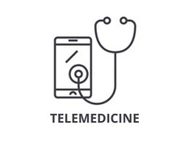

APPLICATIONS:
Mental health treatment: Providing individual therapy, couples counseling, and family therapy sessions remotely.
Telemedicine: Integrating mental health services into primary care settings, offering holistic healthcare solutions.
Workshops and group therapy: Facilitating group sessions and workshops remotely, allowing greater participation and engagement.

Slide 8
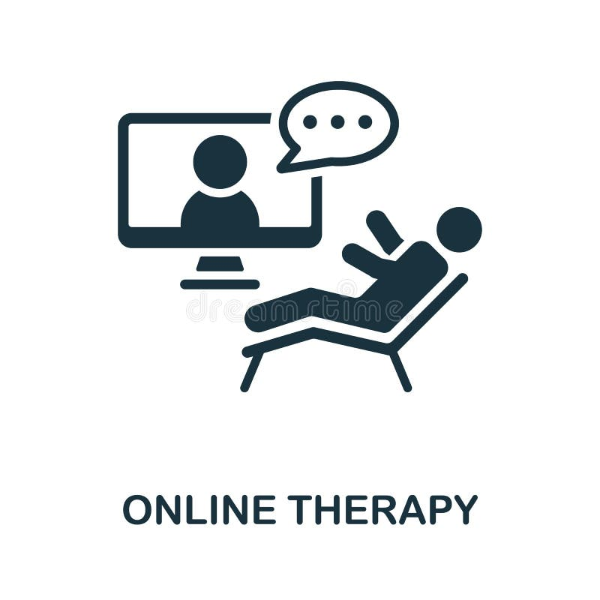
ADVANTAGE
Accessibility: Reach individuals who may not have access to traditional therapy
Convenience: Eliminate barriers like transportation and scheduling conflicts
Comfort: Allow clients to engage from the comfort of their own homes
Anonymity: Provide a sense of anonymity that may encourage open expression
Privacy and Comfort: Providing a safe environment for clients to engage in therapy.
Personalization: Tailoring interventions to meet unique preferences of each individual.

Slide 9
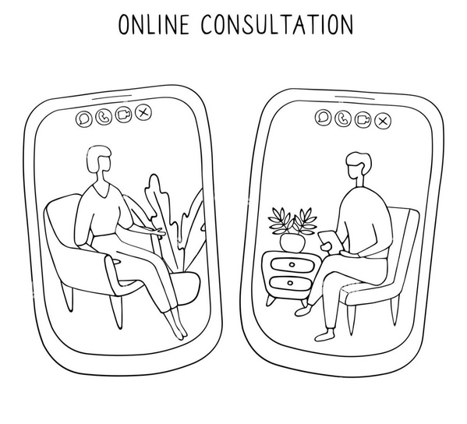
EFFECTIVENESS OF VIRTUAL THERAPY
Research consistently demonstrates the efficacy of virtual therapy across a range of mental health conditions, including depression, anxiety, trauma-related disorders, and substance use disorders. Meta-analyses and systematic reviews have underscored the comparability of outcomes between virtual and in-person therapy modalities, highlighting the potential of virtual therapy as a viable and evidence-based treatment option.

Slide 10

FUTURE SCOPE
The future of virtual therapy systems lies in personalized programs, integrating immersive VR experiences for realism. Mobile and wearable tech ensure accessibility, while data analytics refine interventions. Peer support fosters community, with cultural adaptation for global reach. Integration with healthcare systems streamlines coordination. Continuous feedback and ethical considerations prioritize privacy and security, promising more effective and accessible mental health support.

Slide 11

CONCLUSION
Virtual therapy represents a groundbreaking approach to mental health care that is reshaping the landscape of therapy delivery. By leveraging technology to overcome barriers to access and enhance convenience, virtual therapy has the potential to improve outcomes and reach individuals who may have otherwise gone untreated. As we continue to explore the possibilities of virtual therapy, let us embrace its potential to transform lives and promote mental well-being for all.

Slide 12
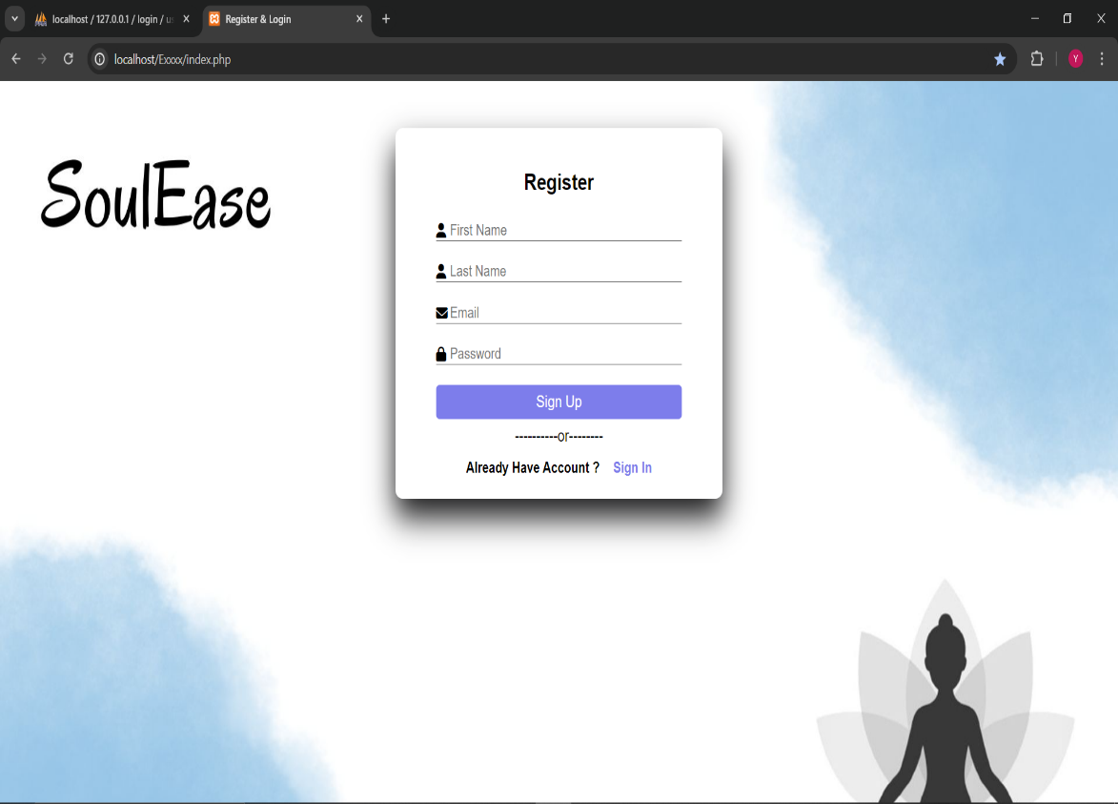
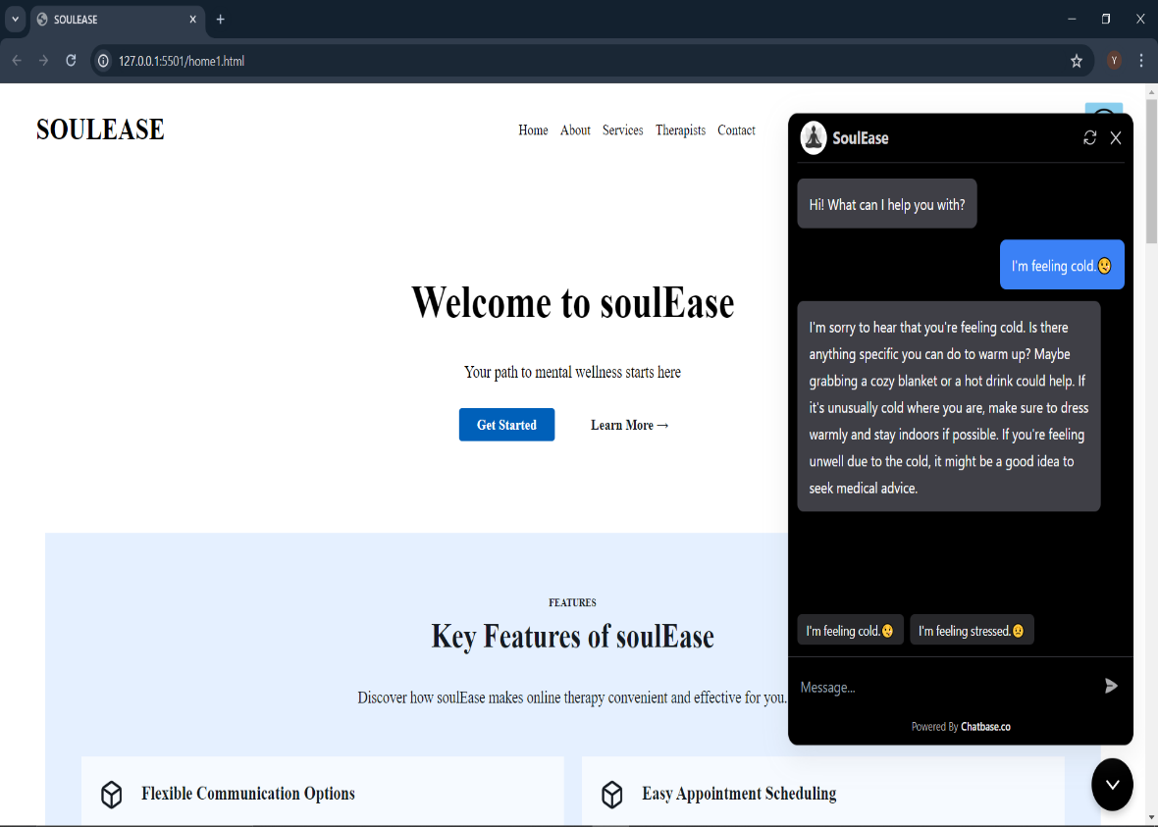
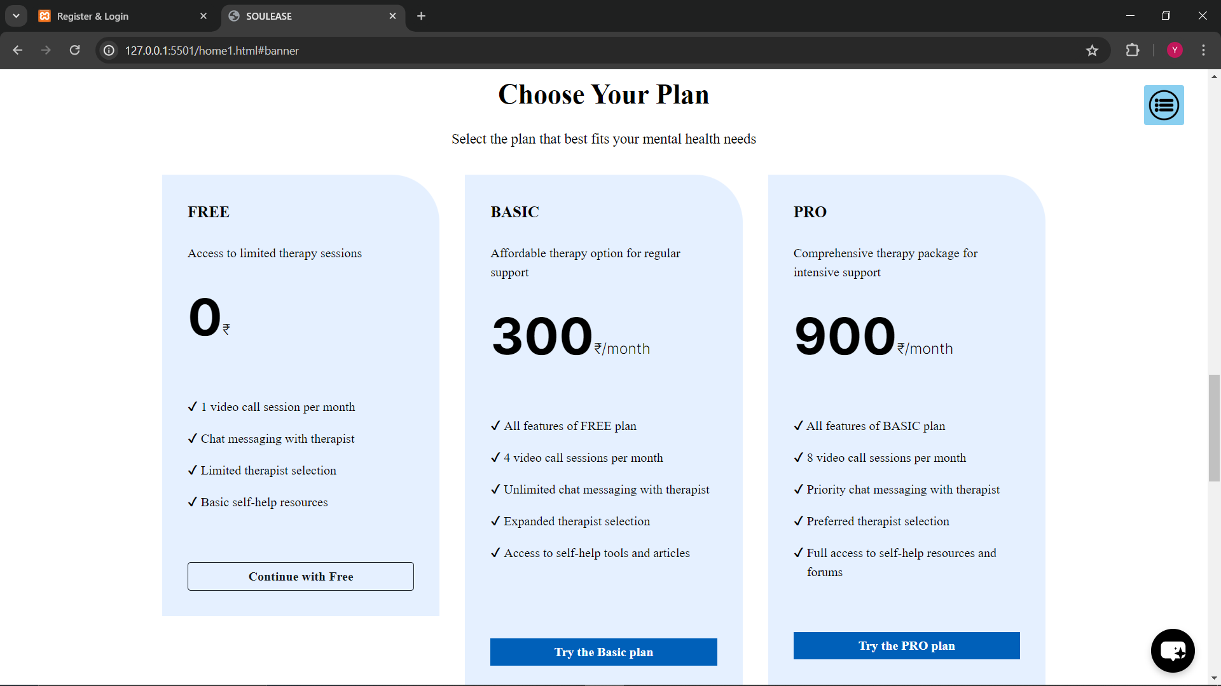
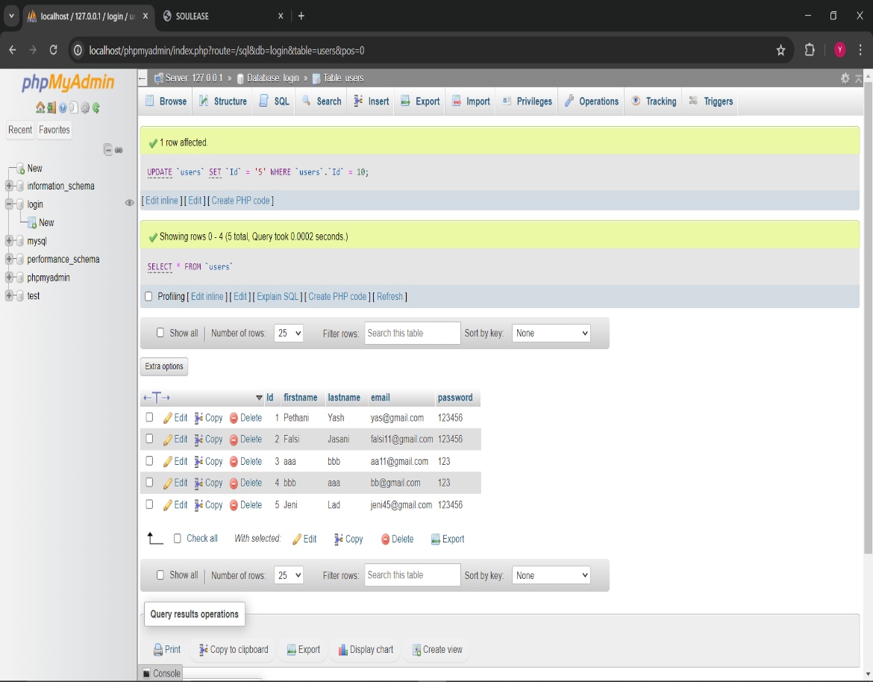

Slide 13

thank you
ENDING WITH THE SOULFUL BEGINING

